Slide 1
PREDICTING SEVERITY IN CAR CRASHES
Chandana Dudam

Slide 2
INTRODUCTION
CURRENTLY, DRIVING THROUGH THE STREETS IN VEHICLES, WHETHER PUBLIC OR OWNED, IS ONE OF THE MOST DAILY ACTIVITIES THAT PEOPLE CARRY OUT. EVEN SO, TRAFFIC ACCIDENTS CAUSE ABOUT 40,000 DEATHS A YEAR ONLY IN THE UNITED STATES.
TO REDUCE THE FREQUENCY AND THE SEVERITY OF CAR COLLISIONS IN A COMMUNITY, AN ALGORITHM MUST BE DEVELOPED TO PREDICT THE SEVERITY OF AN ACCIDENT GIVEN THE CURRENT WEATHER, ROAD AND VISIBILITY CONDITIONS.
WHEN CONDITIONS ARE PRONE TO FATAL ACCIDENTS, THE MODEL DEVELOPED WILL ALLOW DRIVERS TO BE ALERTED TO THE LIKELIHOOD OF AN ACCIDENT AND TO BE REMINDED TO DRIVE CAREFULLY.

Slide 3
DATA ACQUISITION AND CLEANING
THE DATA ACCIDENTS
SET USED
PROVIDED BY SPD AND RECORDED BY
CONTAINS DATA ABOUT CAR
TRAFFIC RECORDS. THE LABEL FOR THE DATA SET IS
'SEVERITYCODE' (TARGET VARIABLE), WHICH
DESCRIBES THE FATALITY OF AN ACCIDENT, IT CAN TAKE 4
VALUES
0: LITTLE TO NO PROBABILITY
1: VERY LOW PROBABILITY - CHANCE OR PROPERTY DAMAGE
2: LOW PROBABILITY - CHANCE OF INJURY
2B: MILD PROBABILITY - CHANCE OF SERIOUS INJURY
3: HIGH PROBABILITY - CHANCE OF FATALITY

Slide 4
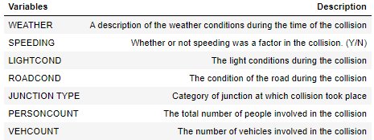
DATA ACQUISITION AND CLEANING
AFTER SOME DATA EXPLORATION AND DISCARDING VARIABLES CORRESPONDING TO ID'S, IT IS DECIDED TO WORK WITH THE FOLLOWING VARIABLES:

Slide 5

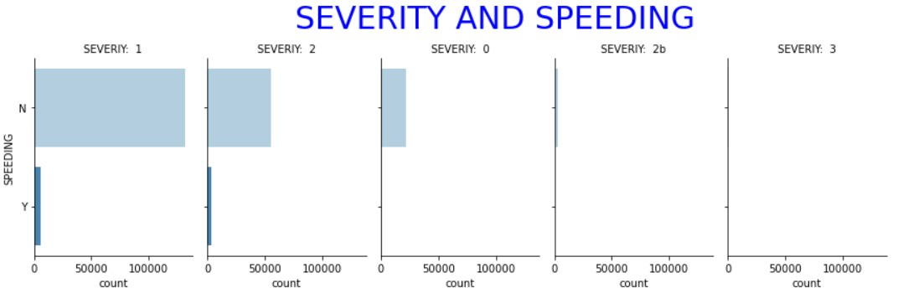
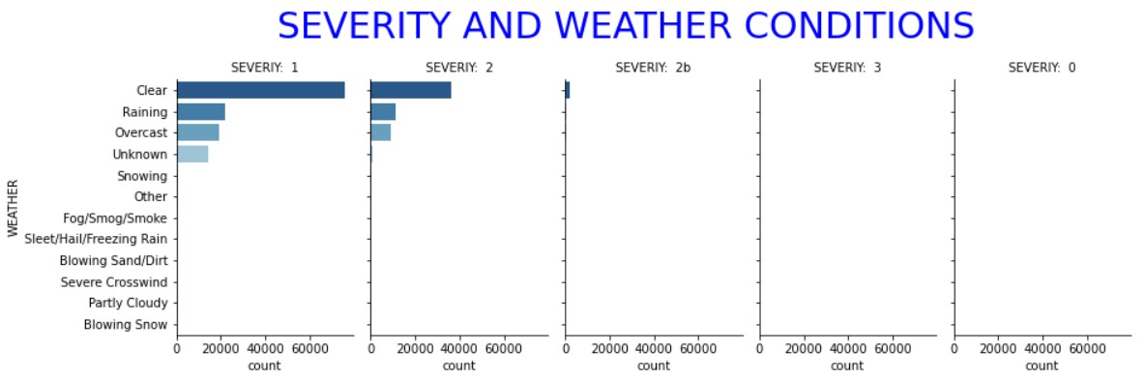
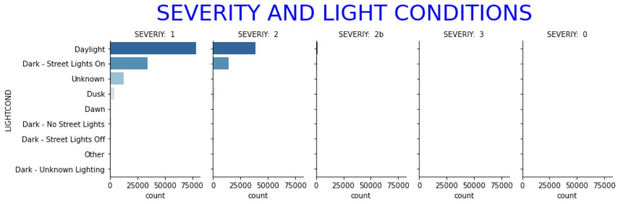
ANALYSIS OF VARIABLES

Slide 6

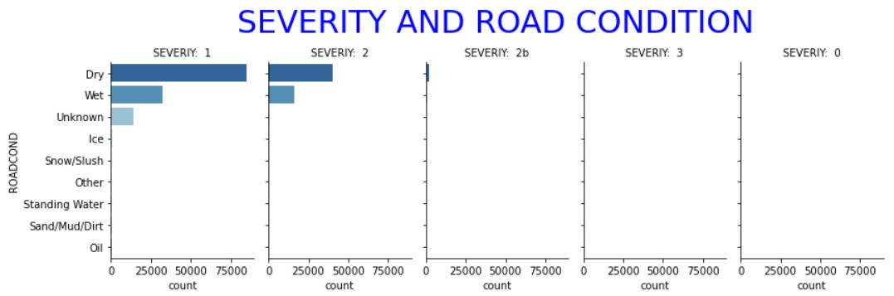
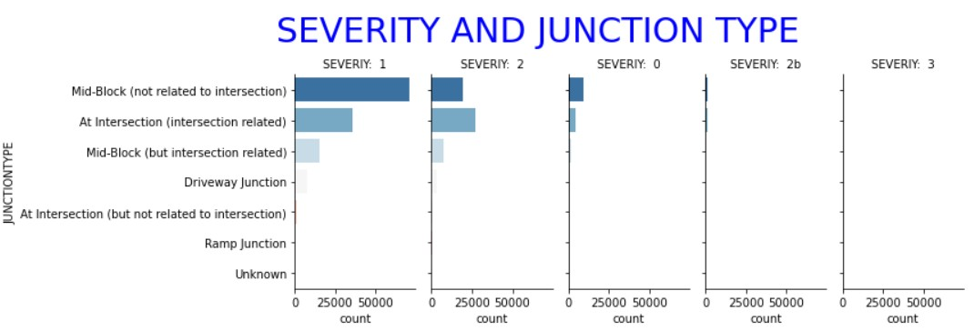
ANALYSIS OF VARIABLES

Slide 7
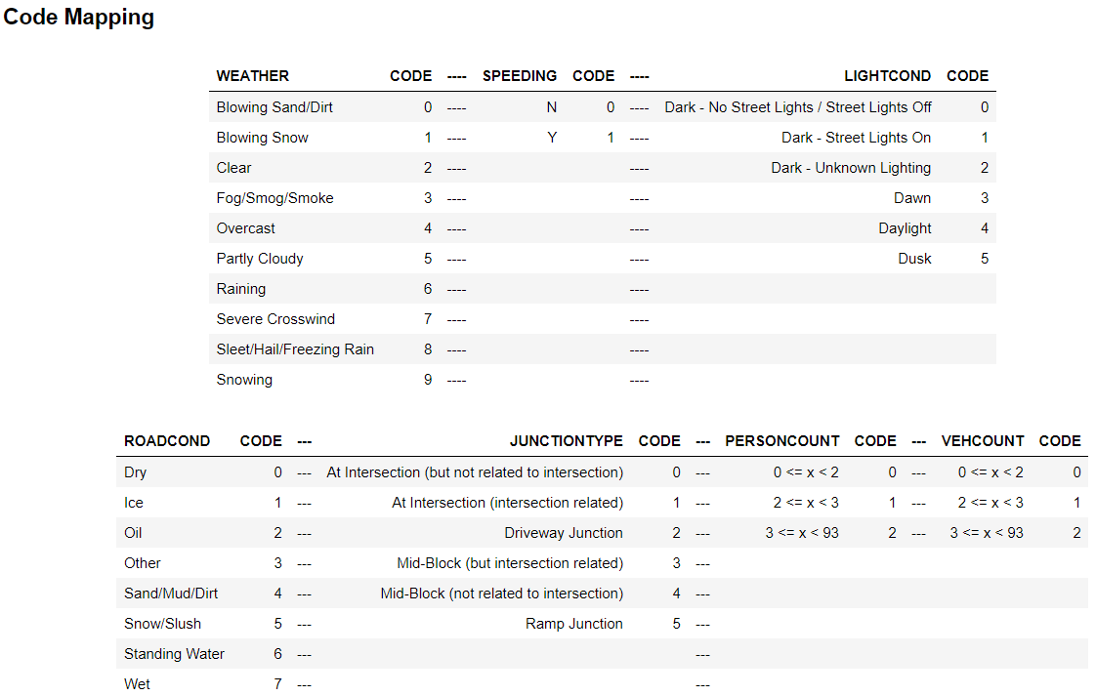
DATA PREPARATION
THE VALUES OF THE CATEGORICAL VARIABLES ARE REPLACED BY NUMERICAL VALUES, AND THE CONTINUOUS VARIABLES ARE COMBINED INTO CATEGORIES ACCORDING TO THE QUARTILES OF EACH VARIABLE TO LATER CONVERT THE DATAFRAME INTO A NUMPY ARRAY AND APPLY THE MODELS FROM THE SKLEARN LIBRARY, FINALLY THE DATA IS BALANCED.

Slide 8






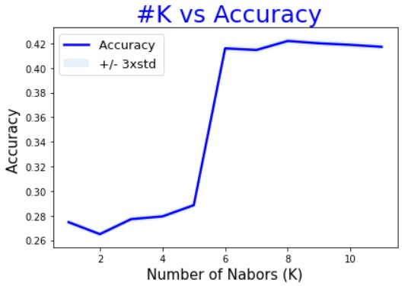
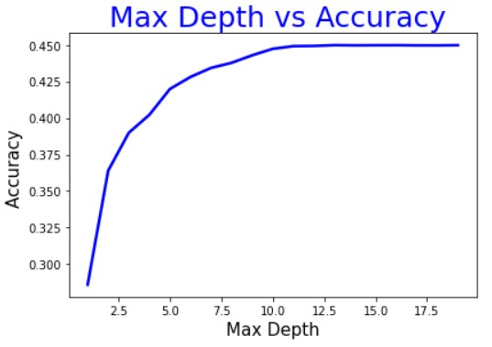




MODELING
KNN
DECISION TREE
LOGISTIC REGRESSION
KNN

Slide 9


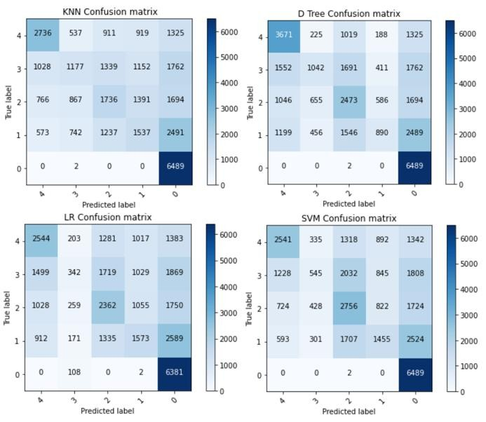
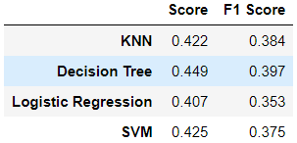
MODEL EVALUATION

Slide 10


CONCLUSION
THE PURPOSE OF THIS PROJECT WAS TO PREDICT THE SEVERITY OF A CAR COLLISSION BASED ON THE CURRENT WEATHER, ROAD AND VISIBILITY CONDITIONS THROUGH THE DEVELOPMENT OF AN ALGORITHM IN WHICH ALL THE PRINCIPLES OF DATA SCIENCE WERE DEVELOPED.
USING DIFFERENT PREDICTION MODELS IT WAS OBTAINED THAT THE MOST SUITABLE MODEL IS THE DECISION TREE WITH AN ACCURACY OF 45%, THIS IS NOT A DESIRED VALUE AS IT IS TOO LOW TO CONSIDER THAT THE PREDICTION MODEL IS CORRECT.
WORK SHOULD CONTINUE ON THE MODEL TO IMPROVE ITS ACCURACY BY PRIOR MANIPULATION OF THE DATA, RETHINKING THE VARIABLES THAT ARE CONSIDERED IMPORTANT.

